Slide 1
Chain Data Structure
Noah Malhi
Prashant Kumar
Quentin Jimenez
Advisors:
Dov Kruger
Raghav Daga

Slide 2
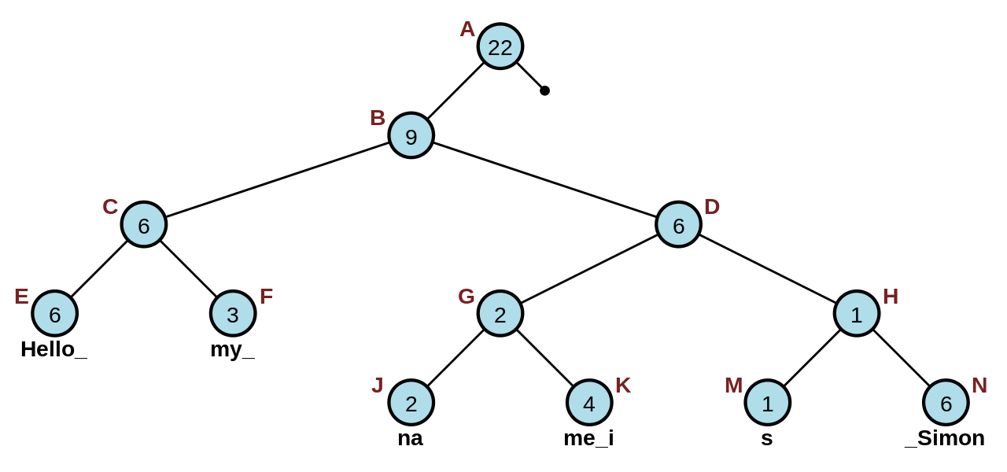
Literature
New concept by Professor Dov Kruger
Ropes: Boehm and Russ
Binary tree
Leaf nodes hold strings
Internal Nodes hold length of the strings to the left
Sample rope: (image: wikipedia) String: Hello my name is Simon

Slide 3
Problem Statement
The String Class: - Array based object for streaming char - Insertion becomes a problem for large objects
Chain is an efficient tree structure for reading extremely large files.
Chain is a hybrid concept by Prof. Dov Kruger.
Leaves of the tree are lines, and each individual line is a conventional string.

Slide 4
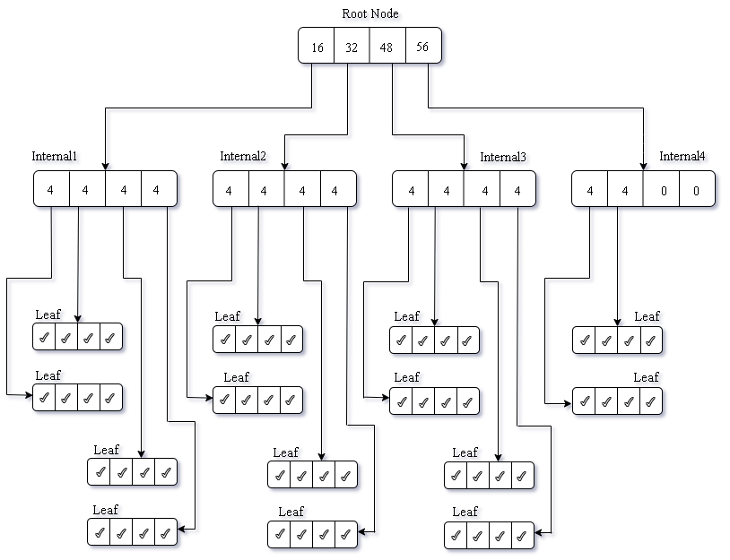
Structure
M-ary Trees.
Rules: at most m children Special cases: binary , ternary tree
Root Node- Pointer to internal nodes counter for #lines
Internal Nodes- Pointer to internal/leaf counter for #lines
Leaf Nodes Pointer to String (which is a line)

Slide 5
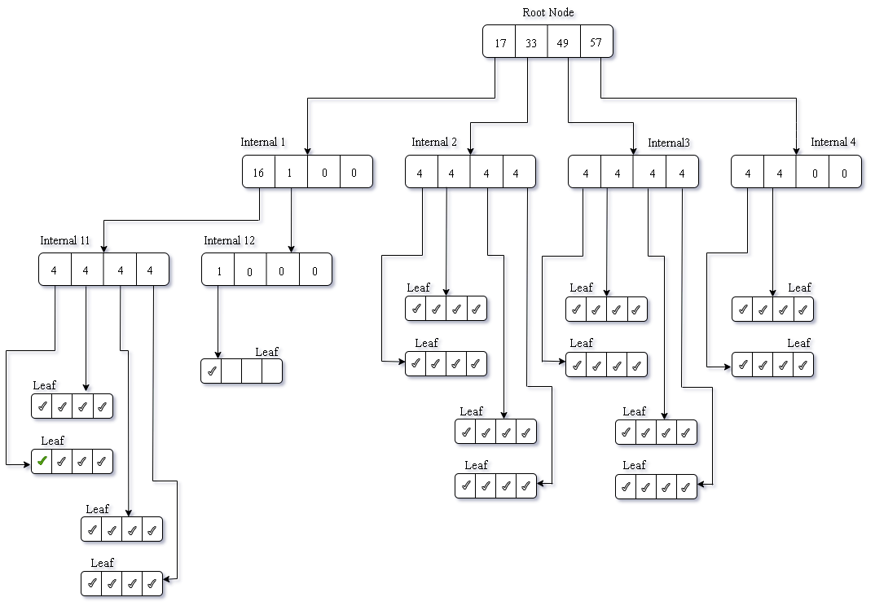
Insert start
Check space in Internal1
Split Internal1
Insert at pos1
Shift everything to right

Slide 6
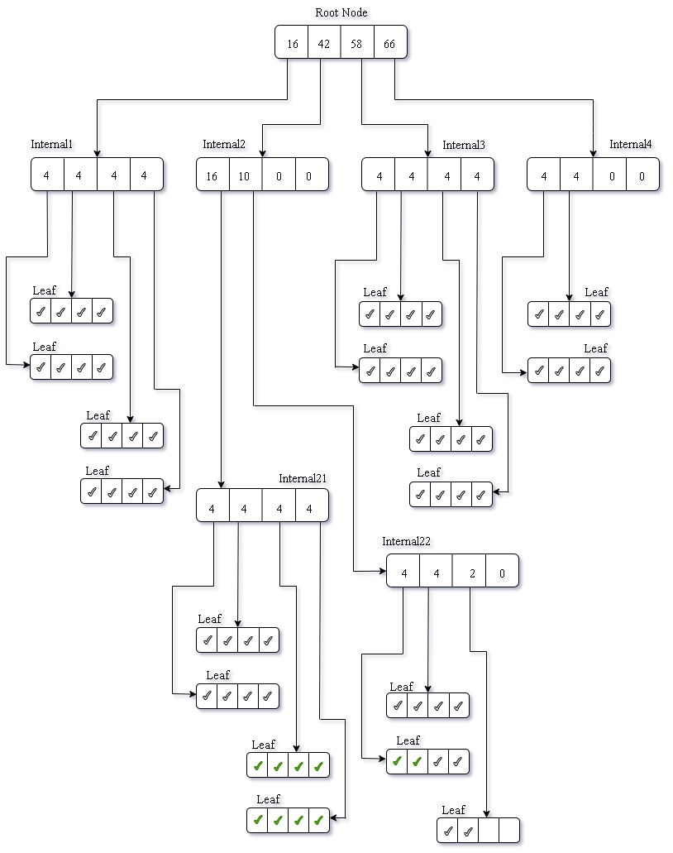
Insert middle
Insert 10 lines at pos 25

Slide 7
Base Struct: refer.
M-ary Trees.
Rules: at most m children Special cases: binary , ternary tree
Root Node- Pointer to internal nodes counter for #lines
Internal Nodes- Pointer to internal/leaf counter for #lines
Leaf Nodes Pointer to String (which is a line)

Slide 8
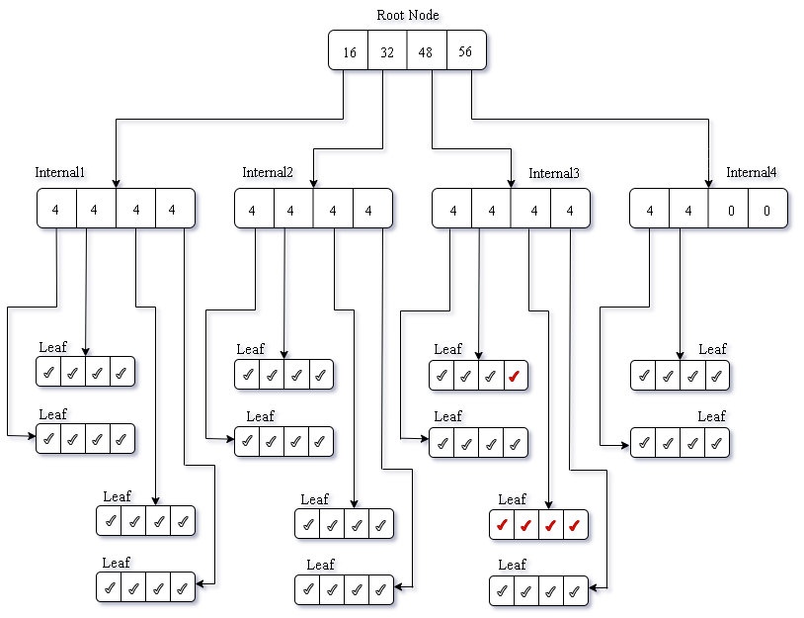
Delete-1
Delete 5 lines at pos 40

Slide 9
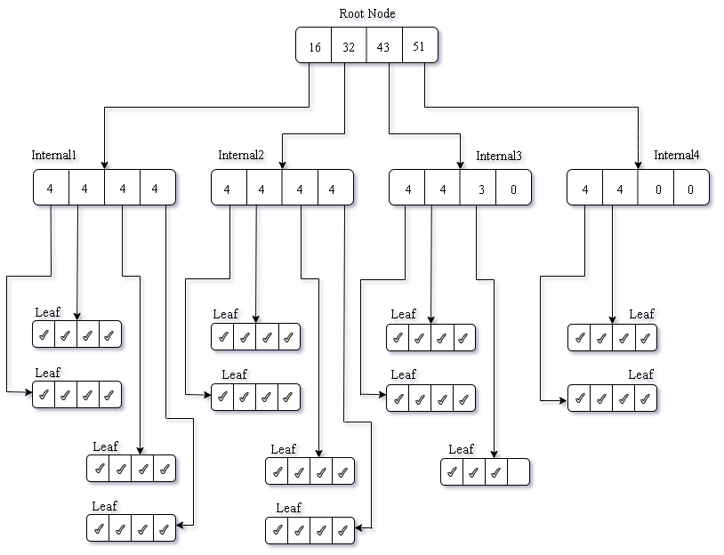
Delete-2

Slide 10
Progress
Issues, TODO

Slide 11
How are we different?
Each line is a node, so we use about an order of magnitude lower number of nodes.
Ropes are binary trees. The depth cannot be controlled.
Chain can be higher order trees, leading to very fat tree structures.
Adv/ Disadv
Handling large files
Common use case: add start/ add end- faster access for chain
Disadv.
Changing words in lines- delete+ change string + insert (complex) as compared to ropes

Slide 12
Complexity Analysis
Assumption: Each word in English language is 8-10 char. Average line length is 8-10 words.
String Size= N characters
Rope- n nodes
M-ary Tree -n nodes (n is differernt for rope and chain)
Example: 100MB text file 1 char = 1 byte 1MB = 1 millions char 100MB = 100 million char/ 10 million words/ 1 million lines.
#nodes_rope ~ 10 million, #nodes_chain ~ 1/M million ~ 250k for a 4-way tree
Change Line, Change Word
 | String | Rope | Chain
Insert | O(N) | Olog(n) | Olog(n)
Delete | O(N) | Olog(n) | Olog(n)
Search | O(N) | Olog(n) | Olog(n)

Slide 13
Conclusion and Future Work
Conc: Novel idea imp
Hybrid of rope and str
Comparison with ropes-
Future Work:Optimize- balanced trees, Integration with mempools,

Slide 14
Thank You!
Questions?
Noah Malhi
Prashant Kumar
Quentin Jimenez

